Slide 1
Chapter 5:
Advanced Database Searching
Jonathan Pevsner, Ph.D.
pevsner@kennedykrieger.org
Bioinformatics and Functional Genomics
(Wiley-Liss, 3rd edition, 2015)
You may use this PowerPoint for teaching purposes

Slide 2
Learning objectives
define a position-specific scoring matrix (PSSM);
explain how position-specific iterated BLAST (PSI-BLAST) and DELTA-BLAST greatly improve the sensitivity of BLAST protein searches;
describe profile hidden Markov models (HMMs) and explain their advantages over BLAST for database searching;
explain how spaced seed strategies improve the sensitivity of DNA searches; and
describe how millions of next-generation sequencing reads are aligned to a reference genome.

Slide 3
Outline
Introduction
Specialized BLAST sites
Organism-specific BLAST sites; specialized algorithms Finding distantly related proteins: PSI-BLAST) and DELTA-BLAST Reverse Position-Specific BLAST Domain enhanced lookup time Accelerated BLAST (DELTA-BLAST) Assessing performance of PSI-BLAST and DELTA-BLAST Pattern-hit initiated BLAST (PHI-BLAST)
Profile searches: Hidden Markov Models and HMMER
BLAST-like alignment tools to search genomic DNA
Benchmarking to assess genomic alignment performance
PatternHunter, BLASTZ, Enredo/Pecan, MegaBLAST, BLAT, LAGAN, SSAHA2
Aligning NGS reads to a reference genome
Alignment based on hash tables; Burrows–Wheeler transform
Perspective

Slide 4
Three problems standard BLAST cannot solve
[1] Use human beta globin as a query against human RefSeq proteins, and BLASTP does not “find” human myoglobin. This is because the two proteins are too distantly related. PSI-BLAST at NCBI as well as hidden Markov models easily solve this problem.
[2] How can we search using 10,000 base pairs as a query, or even millions of base pairs? Many BLAST-like tools for genomic DNA are available such as PatternHunter, Megablast, BLAT, and LASTZ.
[3] How can we align tens of millions of short reads to a reference genome?
Notes:
4

Slide 5
Outline
Introduction
Specialized BLAST sites
Organism-specific BLAST sites; specialized algorithms Finding distantly related proteins: PSI-BLAST) and DELTA-BLAST Reverse Position-Specific BLAST Domain enhanced lookup time Accelerated BLAST (DELTA-BLAST) Assessing performance of PSI-BLAST and DELTA-BLAST Pattern-hit initiated BLAST (PHI-BLAST)
Profile searches: Hidden Markov Models and HMMER
BLAST-like alignment tools to search genomic DNA
Benchmarking to assess genomic alignment performance
PatternHunter, BLASTZ, Enredo/Pecan, MegaBLAST, BLAT, LAGAN, SSAHA2
Aligning NGS reads to a reference genome
Alignment based on hash tables; Burrows–Wheeler transform
Perspective

Slide 6
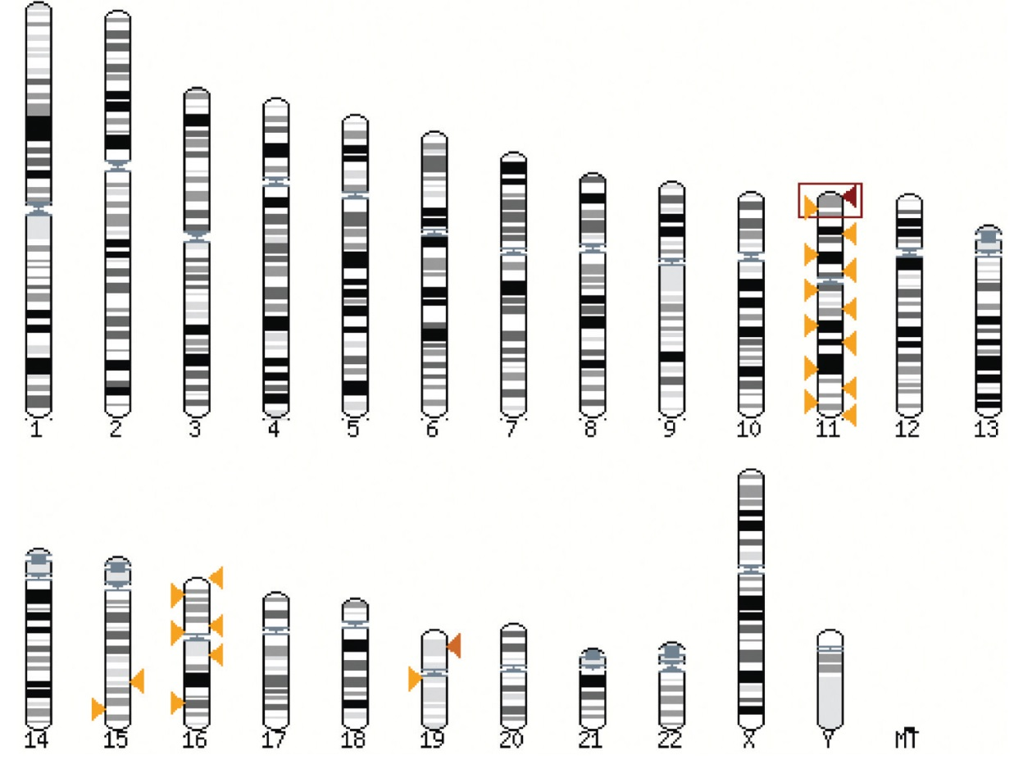
There are hundreds of BLAST servers;
Ensembl is a prominent example
B&FG 3e
Fig. 5.1
Page 169
Ensembl can show database matches conveniently superimposed on an ideogram of chromosomes

Slide 7
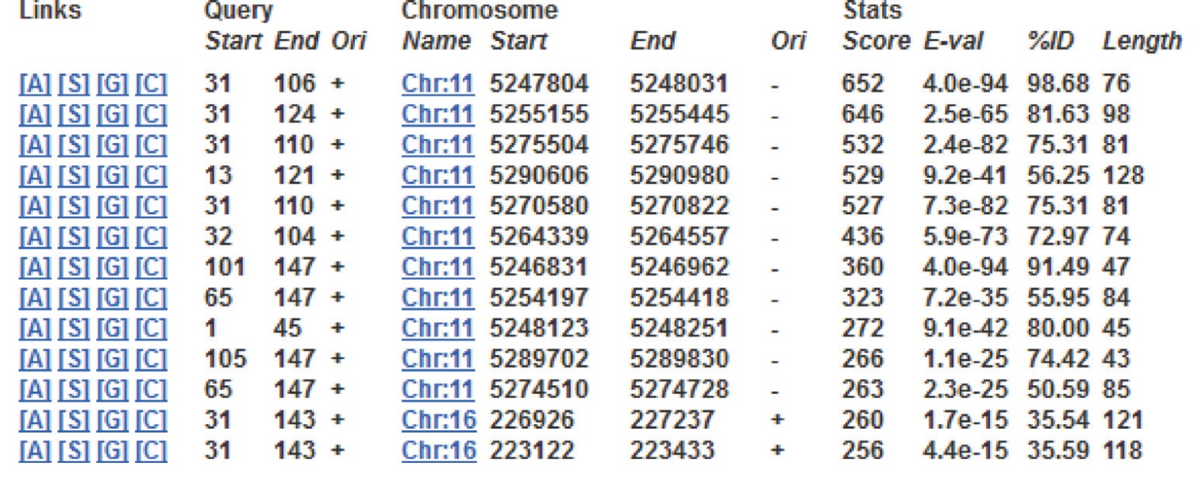
There are hundreds of BLAST servers;
Ensembl is a prominent example
B&FG 3e
Fig. 5.2
Page 169
Ensembl BLAST output summarizes scores, expect values and other features.

Slide 8
Specialized BLAST-related algorithms
There are numerous specialized BLAST-related algorithms
BLAST of next-generation sequence (NGS) data

Slide 9
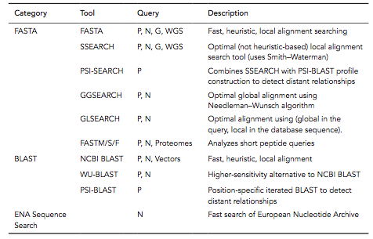
Sequence similarity searching tools at EBI
B&FG 3e
Table 5.1
Page 171
P, protein; N, nucleotide; G, genomes; WGS, whole-genome shotgun

Slide 10
Outline
Introduction
Specialized BLAST sites
Organism-specific BLAST sites; specialized algorithms Finding distantly related proteins: PSI-BLAST) and DELTA-BLAST Reverse Position-Specific BLAST Domain enhanced lookup time Accelerated BLAST (DELTA-BLAST) Assessing performance of PSI-BLAST and DELTA-BLAST Pattern-hit initiated BLAST (PHI-BLAST)
Profile searches: Hidden Markov Models and HMMER
BLAST-like alignment tools to search genomic DNA
Benchmarking to assess genomic alignment performance
PatternHunter, BLASTZ, Enredo/Pecan, MegaBLAST, BLAT, LAGAN, SSAHA2
Aligning NGS reads to a reference genome
Alignment based on hash tables; Burrows–Wheeler transform
Perspective

Slide 11
Position specific iterated BLAST:
PSI-BLAST
The purpose of PSI-BLAST is to look deeper into the database for matches to your query protein sequence by employing a scoring matrix that is customized to your query.

Slide 12
PSI-BLAST is performed in five steps
[1] Select a query and search it against a protein database
B&FG 3e
Page 172

Slide 13
PSI-BLAST is performed in five steps
[1] Select a query and search it against a protein database
[2] PSI-BLAST constructs a multiple sequence alignment
then creates a “profile” or specialized position-specific
scoring matrix (PSSM)
B&FG 3e
Page 172

Slide 14
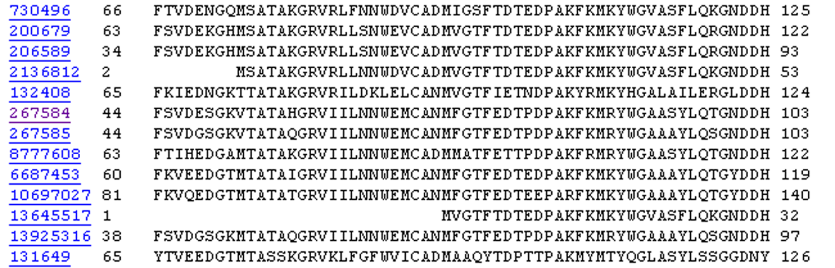
Inspect the BLASTP output to identify empirical “rules” regarding amino acids tolerated at each position
R,I,K
C
D,E,T
K,R,T
N,L,Y,G

Slide 15
A R N D C Q E G H I L K M F P S T W Y V
1 M -1 -2 -2 -3 -2 -1 -2 -3 -2 1 2 -2 6 0 -3 -2 -1 -2 -1 1
2 K -1 1 0 1 -4 2 4 -2 0 -3 -3 3 -2 -4 -1 0 -1 -3 -2 -3
3 W -3 -3 -4 -5 -3 -2 -3 -3 -3 -3 -2 -3 -2 1 -4 -3 -3 12 2 -3
4 V 0 -3 -3 -4 -1 -3 -3 -4 -4 3 1 -3 1 -1 -3 -2 0 -3 -1 4
5 W -3 -3 -4 -5 -3 -2 -3 -3 -3 -3 -2 -3 -2 1 -4 -3 -3 12 2 -3
6 A 5 -2 -2 -2 -1 -1 -1 0 -2 -2 -2 -1 -1 -3 -1 1 0 -3 -2 0
7 L -2 -2 -4 -4 -1 -2 -3 -4 -3 2 4 -3 2 0 -3 -3 -1 -2 -1 1
8 L -1 -3 -3 -4 -1 -3 -3 -4 -3 2 2 -3 1 3 -3 -2 -1 -2 0 3
9 L -1 -3 -4 -4 -1 -2 -3 -4 -3 2 4 -3 2 0 -3 -3 -1 -2 -1 2
10 L -2 -2 -4 -4 -1 -2 -3 -4 -3 2 4 -3 2 0 -3 -3 -1 -2 -1 1
11 A 5 -2 -2 -2 -1 -1 -1 0 -2 -2 -2 -1 -1 -3 -1 1 0 -3 -2 0
12 A 5 -2 -2 -2 -1 -1 -1 0 -2 -2 -2 -1 -1 -3 -1 1 0 -3 -2 0
13 W -2 -3 -4 -4 -2 -2 -3 -4 -3 1 4 -3 2 1 -3 -3 -2 7 0 0
14 A 3 -2 -1 -2 -1 -1 -2 4 -2 -2 -2 -1 -2 -3 -1 1 -1 -3 -3 -1
15 A 2 -1 0 -1 -2 2 0 2 -1 -3 -3 0 -2 -3 -1 3 0 -3 -2 -2
16 A 4 -2 -1 -2 -1 -1 -1 3 -2 -2 -2 -1 -1 -3 -1 1 0 -3 -2 -1
...
37 S 2 -1 0 -1 -1 0 0 0 -1 -2 -3 0 -2 -3 -1 4 1 -3 -2 -2
38 G 0 -3 -1 -2 -3 -2 -2 6 -2 -4 -4 -2 -3 -4 -2 0 -2 -3 -3 -4
39 T 0 -1 0 -1 -1 -1 -1 -2 -2 -1 -1 -1 -1 -2 -1 1 5 -3 -2 0
40 W -3 -3 -4 -5 -3 -2 -3 -3 -3 -3 -2 -3 -2 1 -4 -3 -3 12 2 -3
41 Y -2 -2 -2 -3 -3 -2 -2 -3 2 -2 -1 -2 -1 3 -3 -2 -2 2 7 -1
42 A 4 -2 -2 -2 -1 -1 -1 0 -2 -2 -2 -1 -1 -3 -1 1 0 -3 -2 0
20 amino acids
all the amino acids from position 1 to the end of your PSI-BLAST query protein

Slide 16
A R N D C Q E G H I L K M F P S T W Y V
1 M -1 -2 -2 -3 -2 -1 -2 -3 -2 1 2 -2 6 0 -3 -2 -1 -2 -1 1
2 K -1 1 0 1 -4 2 4 -2 0 -3 -3 3 -2 -4 -1 0 -1 -3 -2 -3
3 W -3 -3 -4 -5 -3 -2 -3 -3 -3 -3 -2 -3 -2 1 -4 -3 -3 12 2 -3
4 V 0 -3 -3 -4 -1 -3 -3 -4 -4 3 1 -3 1 -1 -3 -2 0 -3 -1 4
5 W -3 -3 -4 -5 -3 -2 -3 -3 -3 -3 -2 -3 -2 1 -4 -3 -3 12 2 -3
6 A 5 -2 -2 -2 -1 -1 -1 0 -2 -2 -2 -1 -1 -3 -1 1 0 -3 -2 0
7 L -2 -2 -4 -4 -1 -2 -3 -4 -3 2 4 -3 2 0 -3 -3 -1 -2 -1 1
8 L -1 -3 -3 -4 -1 -3 -3 -4 -3 2 2 -3 1 3 -3 -2 -1 -2 0 3
9 L -1 -3 -4 -4 -1 -2 -3 -4 -3 2 4 -3 2 0 -3 -3 -1 -2 -1 2
10 L -2 -2 -4 -4 -1 -2 -3 -4 -3 2 4 -3 2 0 -3 -3 -1 -2 -1 1
11 A 5 -2 -2 -2 -1 -1 -1 0 -2 -2 -2 -1 -1 -3 -1 1 0 -3 -2 0
12 A 5 -2 -2 -2 -1 -1 -1 0 -2 -2 -2 -1 -1 -3 -1 1 0 -3 -2 0
13 W -2 -3 -4 -4 -2 -2 -3 -4 -3 1 4 -3 2 1 -3 -3 -2 7 0 0
14 A 3 -2 -1 -2 -1 -1 -2 4 -2 -2 -2 -1 -2 -3 -1 1 -1 -3 -3 -1
15 A 2 -1 0 -1 -2 2 0 2 -1 -3 -3 0 -2 -3 -1 3 0 -3 -2 -2
16 A 4 -2 -1 -2 -1 -1 -1 3 -2 -2 -2 -1 -1 -3 -1 1 0 -3 -2 -1
...
37 S 2 -1 0 -1 -1 0 0 0 -1 -2 -3 0 -2 -3 -1 4 1 -3 -2 -2
38 G 0 -3 -1 -2 -3 -2 -2 6 -2 -4 -4 -2 -3 -4 -2 0 -2 -3 -3 -4
39 T 0 -1 0 -1 -1 -1 -1 -2 -2 -1 -1 -1 -1 -2 -1 1 5 -3 -2 0
40 W -3 -3 -4 -5 -3 -2 -3 -3 -3 -3 -2 -3 -2 1 -4 -3 -3 12 2 -3
41 Y -2 -2 -2 -3 -3 -2 -2 -3 2 -2 -1 -2 -1 3 -3 -2 -2 2 7 -1
42 A 4 -2 -2 -2 -1 -1 -1 0 -2 -2 -2 -1 -1 -3 -1 1 0 -3 -2 0

Slide 17
A R N D C Q E G H I L K M F P S T W Y V
1 M -1 -2 -2 -3 -2 -1 -2 -3 -2 1 2 -2 6 0 -3 -2 -1 -2 -1 1
2 K -1 1 0 1 -4 2 4 -2 0 -3 -3 3 -2 -4 -1 0 -1 -3 -2 -3
3 W -3 -3 -4 -5 -3 -2 -3 -3 -3 -3 -2 -3 -2 1 -4 -3 -3 12 2 -3
4 V 0 -3 -3 -4 -1 -3 -3 -4 -4 3 1 -3 1 -1 -3 -2 0 -3 -1 4
5 W -3 -3 -4 -5 -3 -2 -3 -3 -3 -3 -2 -3 -2 1 -4 -3 -3 12 2 -3
6 A 5 -2 -2 -2 -1 -1 -1 0 -2 -2 -2 -1 -1 -3 -1 1 0 -3 -2 0
7 L -2 -2 -4 -4 -1 -2 -3 -4 -3 2 4 -3 2 0 -3 -3 -1 -2 -1 1
8 L -1 -3 -3 -4 -1 -3 -3 -4 -3 2 2 -3 1 3 -3 -2 -1 -2 0 3
9 L -1 -3 -4 -4 -1 -2 -3 -4 -3 2 4 -3 2 0 -3 -3 -1 -2 -1 2
10 L -2 -2 -4 -4 -1 -2 -3 -4 -3 2 4 -3 2 0 -3 -3 -1 -2 -1 1
11 A 5 -2 -2 -2 -1 -1 -1 0 -2 -2 -2 -1 -1 -3 -1 1 0 -3 -2 0
12 A 5 -2 -2 -2 -1 -1 -1 0 -2 -2 -2 -1 -1 -3 -1 1 0 -3 -2 0
13 W -2 -3 -4 -4 -2 -2 -3 -4 -3 1 4 -3 2 1 -3 -3 -2 7 0 0
14 A 3 -2 -1 -2 -1 -1 -2 4 -2 -2 -2 -1 -2 -3 -1 1 -1 -3 -3 -1
15 A 2 -1 0 -1 -2 2 0 2 -1 -3 -3 0 -2 -3 -1 3 0 -3 -2 -2
16 A 4 -2 -1 -2 -1 -1 -1 3 -2 -2 -2 -1 -1 -3 -1 1 0 -3 -2 -1
...
37 S 2 -1 0 -1 -1 0 0 0 -1 -2 -3 0 -2 -3 -1 4 1 -3 -2 -2
38 G 0 -3 -1 -2 -3 -2 -2 6 -2 -4 -4 -2 -3 -4 -2 0 -2 -3 -3 -4
39 T 0 -1 0 -1 -1 -1 -1 -2 -2 -1 -1 -1 -1 -2 -1 1 5 -3 -2 0
40 W -3 -3 -4 -5 -3 -2 -3 -3 -3 -3 -2 -3 -2 1 -4 -3 -3 12 2 -3
41 Y -2 -2 -2 -3 -3 -2 -2 -3 2 -2 -1 -2 -1 3 -3 -2 -2 2 7 -1
42 A 4 -2 -2 -2 -1 -1 -1 0 -2 -2 -2 -1 -1 -3 -1 1 0 -3 -2 0
note that a given amino acid (such as alanine) in your query protein can receive different scores for matching alanine—depending on the position in the protein

Slide 18
A R N D C Q E G H I L K M F P S T W Y V
1 M -1 -2 -2 -3 -2 -1 -2 -3 -2 1 2 -2 6 0 -3 -2 -1 -2 -1 1
2 K -1 1 0 1 -4 2 4 -2 0 -3 -3 3 -2 -4 -1 0 -1 -3 -2 -3
3 W -3 -3 -4 -5 -3 -2 -3 -3 -3 -3 -2 -3 -2 1 -4 -3 -3 12 2 -3
4 V 0 -3 -3 -4 -1 -3 -3 -4 -4 3 1 -3 1 -1 -3 -2 0 -3 -1 4
5 W -3 -3 -4 -5 -3 -2 -3 -3 -3 -3 -2 -3 -2 1 -4 -3 -3 12 2 -3
6 A 5 -2 -2 -2 -1 -1 -1 0 -2 -2 -2 -1 -1 -3 -1 1 0 -3 -2 0
7 L -2 -2 -4 -4 -1 -2 -3 -4 -3 2 4 -3 2 0 -3 -3 -1 -2 -1 1
8 L -1 -3 -3 -4 -1 -3 -3 -4 -3 2 2 -3 1 3 -3 -2 -1 -2 0 3
9 L -1 -3 -4 -4 -1 -2 -3 -4 -3 2 4 -3 2 0 -3 -3 -1 -2 -1 2
10 L -2 -2 -4 -4 -1 -2 -3 -4 -3 2 4 -3 2 0 -3 -3 -1 -2 -1 1
11 A 5 -2 -2 -2 -1 -1 -1 0 -2 -2 -2 -1 -1 -3 -1 1 0 -3 -2 0
12 A 5 -2 -2 -2 -1 -1 -1 0 -2 -2 -2 -1 -1 -3 -1 1 0 -3 -2 0
13 W -2 -3 -4 -4 -2 -2 -3 -4 -3 1 4 -3 2 1 -3 -3 -2 7 0 0
14 A 3 -2 -1 -2 -1 -1 -2 4 -2 -2 -2 -1 -2 -3 -1 1 -1 -3 -3 -1
15 A 2 -1 0 -1 -2 2 0 2 -1 -3 -3 0 -2 -3 -1 3 0 -3 -2 -2
16 A 4 -2 -1 -2 -1 -1 -1 3 -2 -2 -2 -1 -1 -3 -1 1 0 -3 -2 -1
...
37 S 2 -1 0 -1 -1 0 0 0 -1 -2 -3 0 -2 -3 -1 4 1 -3 -2 -2
38 G 0 -3 -1 -2 -3 -2 -2 6 -2 -4 -4 -2 -3 -4 -2 0 -2 -3 -3 -4
39 T 0 -1 0 -1 -1 -1 -1 -2 -2 -1 -1 -1 -1 -2 -1 1 5 -3 -2 0
40 W -3 -3 -4 -5 -3 -2 -3 -3 -3 -3 -2 -3 -2 1 -4 -3 -3 12 2 -3
41 Y -2 -2 -2 -3 -3 -2 -2 -3 2 -2 -1 -2 -1 3 -3 -2 -2 2 7 -1
42 A 4 -2 -2 -2 -1 -1 -1 0 -2 -2 -2 -1 -1 -3 -1 1 0 -3 -2 0
note that a given amino acid (such as tryptophan) in your query protein can receive different scores for matching tryptophan—depending on the position in the protein

Slide 19
PSI-BLAST is performed in five steps
[1] Select a query and search it against a protein database
[2] PSI-BLAST constructs a multiple sequence alignment
then creates a “profile” or specialized position-specific
scoring matrix (PSSM)
[3] The PSSM is used as a query against the database
B&FG 3e
Page 172

Slide 20
PSI-BLAST is performed in five steps
[1] Select a query and search it against a protein database
[2] PSI-BLAST constructs a multiple sequence alignment
then creates a “profile” or specialized position-specific
scoring matrix (PSSM)
[3] The PSSM is used as a query against the database
[4] PSI-BLAST estimates statistical significance (E values)
B&FG 3e
Page 172

Slide 21
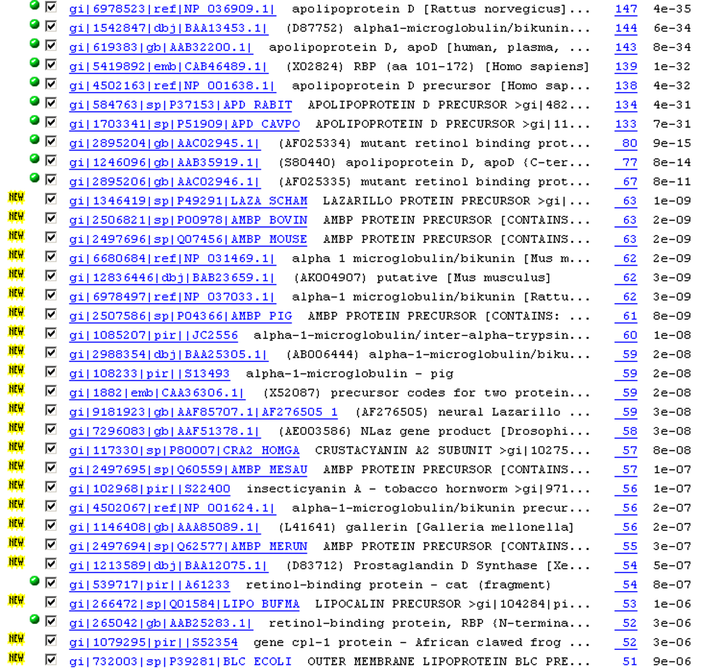

Slide 22
PSI-BLAST is performed in five steps
[1] Select a query and search it against a protein database
[2] PSI-BLAST constructs a multiple sequence alignment
then creates a “profile” or specialized position-specific
scoring matrix (PSSM)
[3] The PSSM is used as a query against the database
[4] PSI-BLAST estimates statistical significance (E values)
[5] Repeat steps [3] and [4] iteratively, typically 5 times.
At each new search, a new profile is used as the query.
B&FG 3e
Page 172

Slide 23
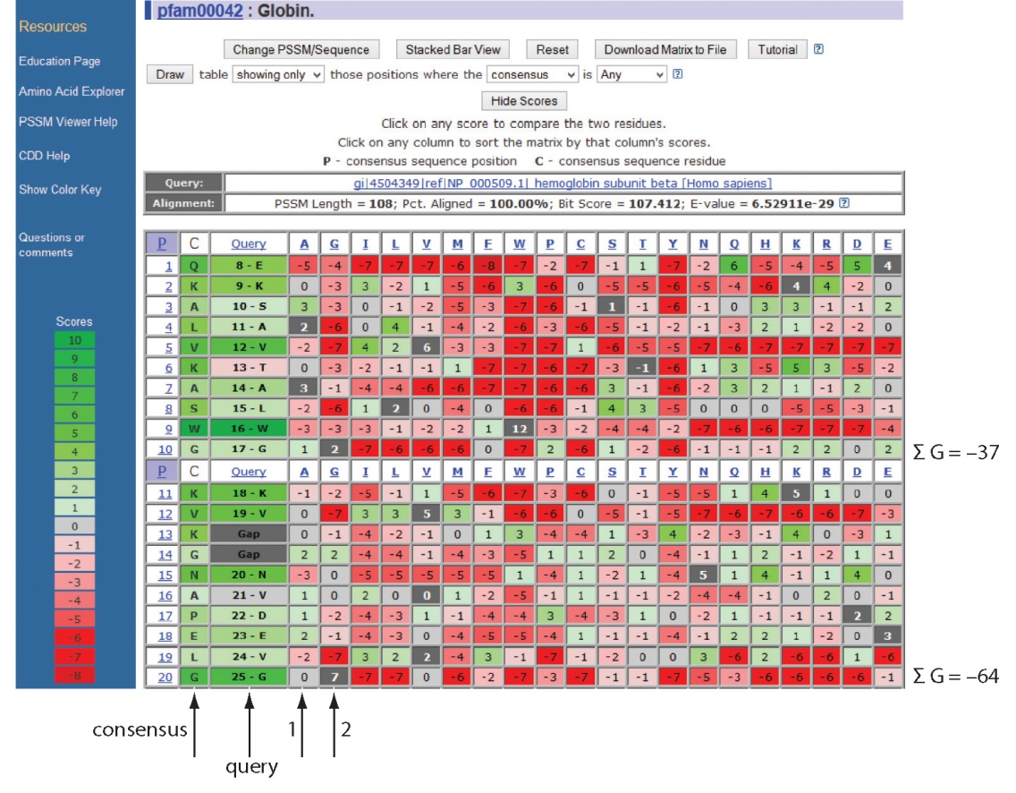
Position-specific scoring matrix (PSSM)
B&FG 3e
Fig. 5.3
Page 173

Slide 24
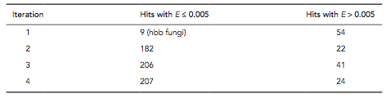
PSI-BLAST: dramatic increase in number of hits
Given this query, a standard BLASTP search would produce about 9 hits with low expect values. This PSI-BLAST search produces >200 hits after 3 or 4 iterations.
B&FG 3e
Table 5.2
Page 174

Slide 25
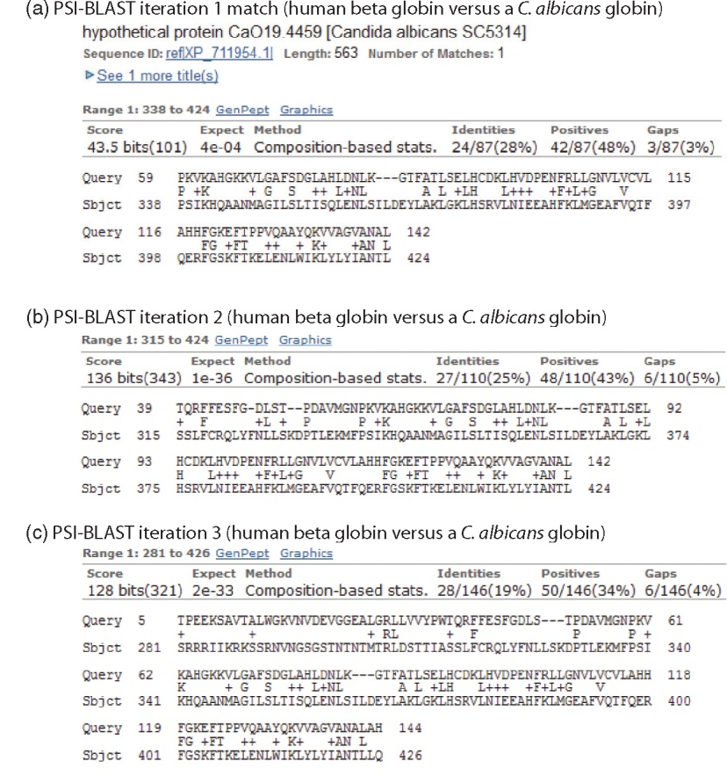
Note that PSI-BLAST E values
can improve dramatically!
After 1st iteration:
Expect = 4e-04
Alignment length = 87 amino acids
After 2nd iteration:
Expect = 1e-36
Alignment length = 110 amino acids
After 3rd iteration:
Expect = 2e-33
Alignment length = 146 amino acids
B&FG 3e
Fig. 5.4
Page 175

Slide 26
The universe of lipocalins (each dot is a protein)
retinol-binding
protein
odorant-binding
protein
apolipoprotein D

Slide 27
Scoring matrices let you focus on the big (or small) picture
retinol-binding
protein
your RBP query

Slide 28
Scoring matrices let you focus on the big (or small) picture
PAM250
PAM30
retinol-binding
protein
retinol-binding
protein
Blosum80
Blosum45

Slide 29
PSI-BLAST generates scoring matrices
more sensitive than PAM or BLOSUM
retinol-binding
protein
retinol-binding
protein

Slide 30
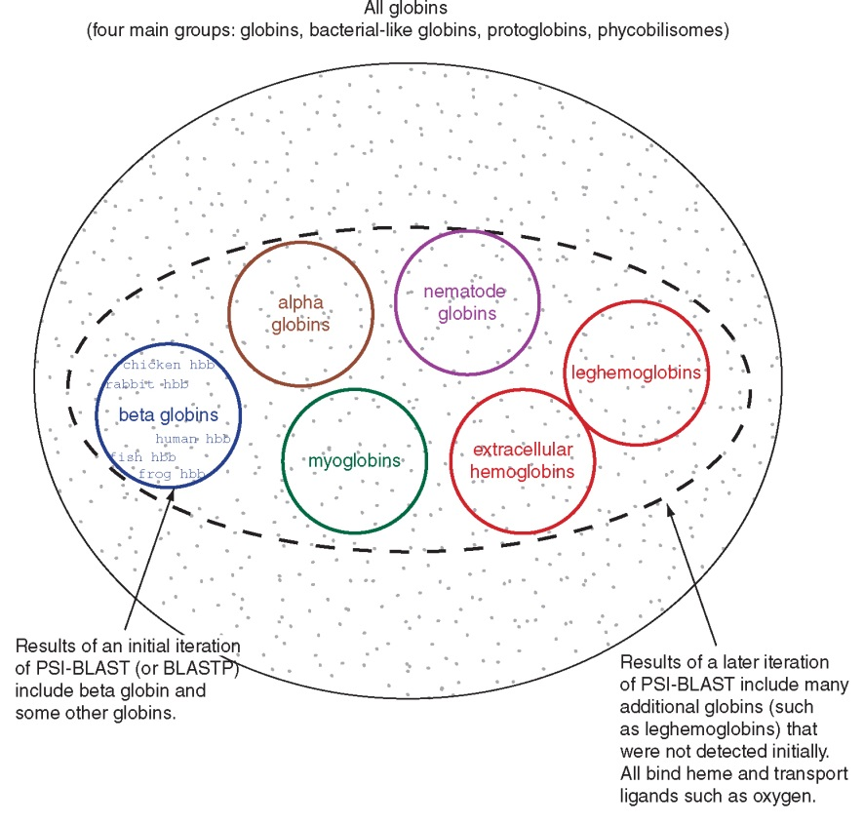
PSI‐BLAST algorithm increases the sensitivity of a database search by detecting homologous matches with relatively low sequence identity
B&FG 3e
Fig. 5.5
Page 176

Slide 31
PSI-BLAST: the problem of corruption
In PSI-BLAST once a match is incorporated into a PSSM it will never be removed, even if it is wrong (i.e. even if it is a false positive that is not truly homologous to the query). Not only will it stay, it may lead to the inclusion of many other related false positive hits.
There are three main approaches to removing false positives:
Filter biased amino acid regions. (This is an option in BLAST.)
Lower the expect value threshold to make the search more stringent.
Visually inspect the output from each PSI-BLAST iteration and remove suspicious matches (by unchecking the corresponding boxes).
B&FG 3e
Page 177

Slide 32
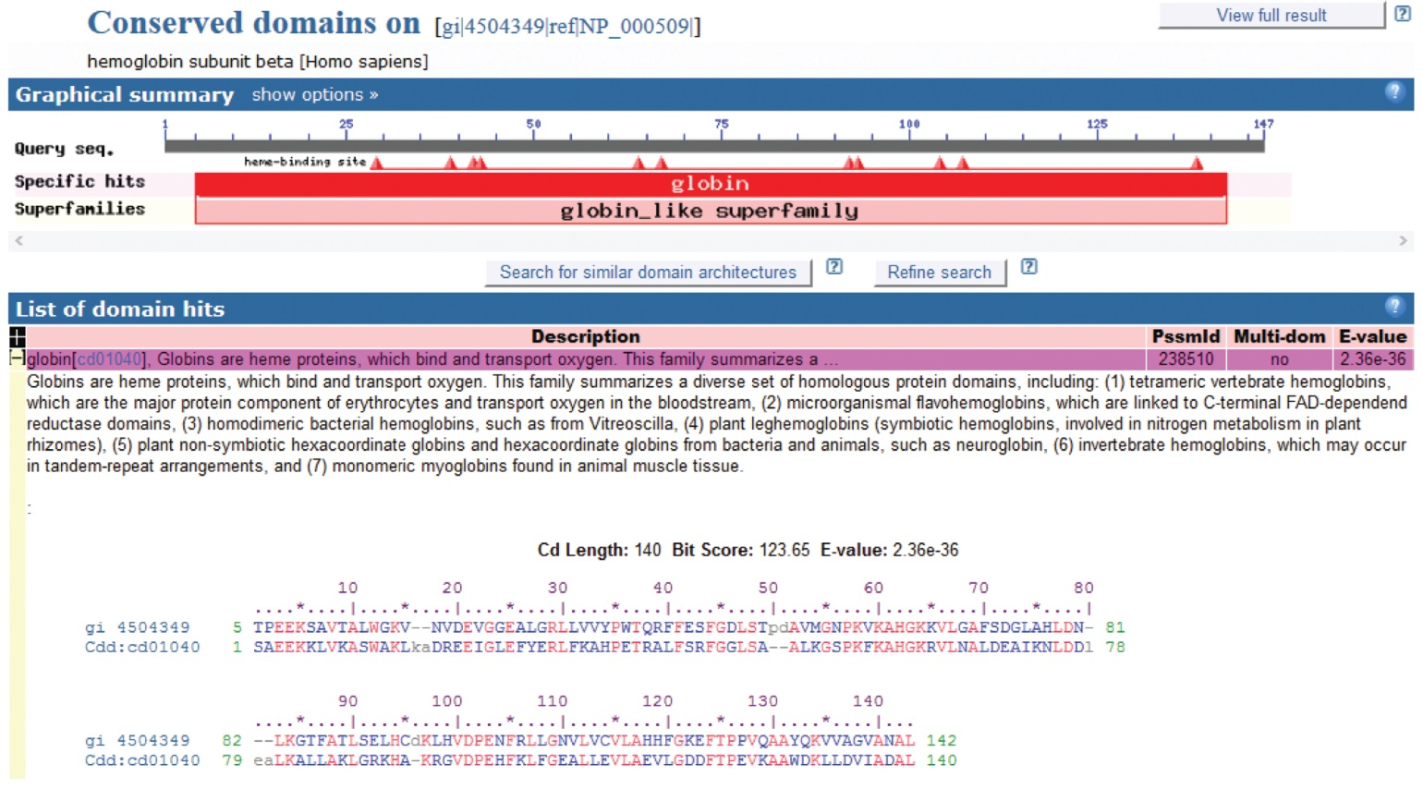
Reverse position-specific BLAST (RPS-BLAST): search a query against a collection of predefined position-specific scoring matrices
B&FG 3e
Fig. 5.6
Page 178
RPS-BLAST searches are incorporated into the Conserved Domain Database (CDD) at NCBI

Slide 33
DELTA-BLAST: better than PSI-BLAST!
In 2012 NCBI introduced DELTA-BLAST (Domain Enhanced Lookup Time Accelerated BLAST) to the family of BLASTP tools.
DELTA-BLAST constructs a PSSM using the results of a Conserved Domain Database (CDD) search, and uses that to search a sequence database.
The results are typically superior to those of PSI-BLAST.

Slide 34
DELTA-BLAST: better than PSI-BLAST!
Domain enhanced lookup time Accelerated BLAST (DELTA-BLAST) is faster, more sensitive and accurate than PSI-BLAST.
PSI-BLAST creates multiple alignments and position-specific scoring matrices (PSSMs).
DELTA-BLAST searches a query against a library of pre-computed PSSMs. One reason DELTA-BLAST outperforms PSI-BLAST is that it results in larger, more complete PSSMs than PSI-BLAST.
Most queries do match a PSSM; if not the search proceeds in a PSI-BLAST-like manner.
One iteration of DELTA-BLAST is recommended.

Slide 35
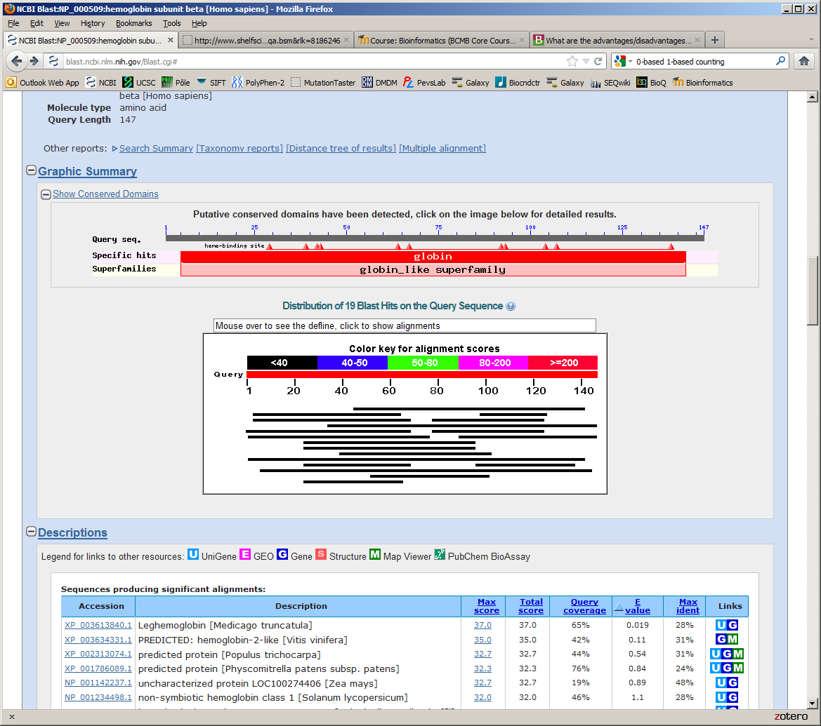
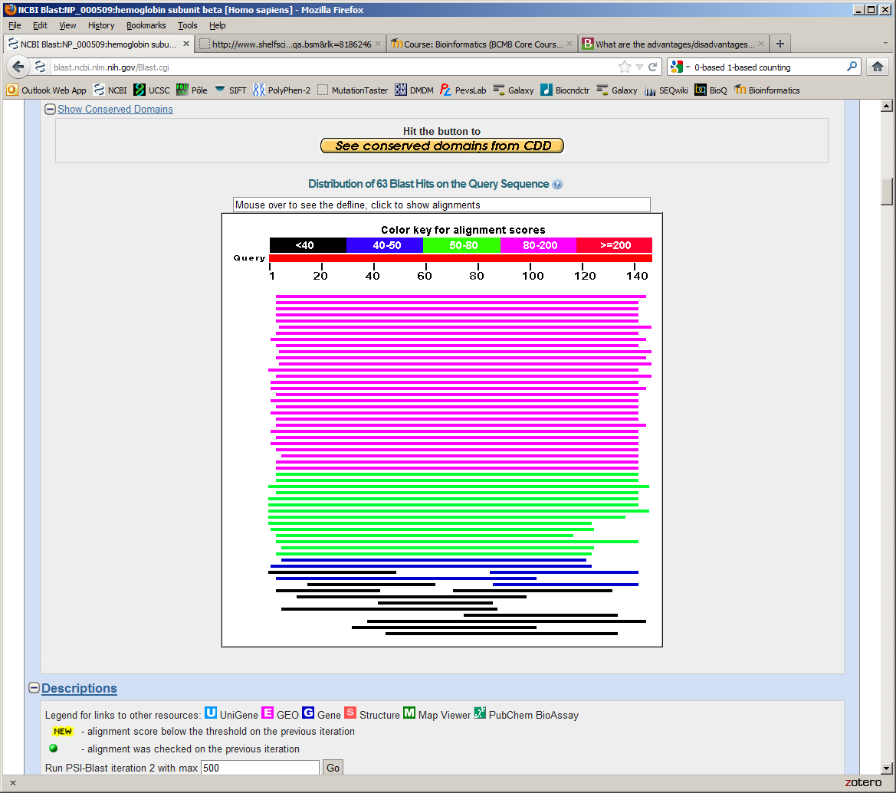
Search HBB (NP_000509) against RefSeq plants…
BLAST
DELTA-BLAST

Slide 36
DELTA-BLAST
DELTA-BLAST is better than PSI-BLAST because it takes advantage of longer PSSMs
If your query does not match any PSSM, DELTA-BLAST simply returns a BLASTP-like result

Slide 37
DELTA-BLAST and PSI-BLAST: assessing performance
To assess the performance of BLASTP, PSI-BLAST, DELTA-BLAST or other programs it is necessary to have a “truth” dataset to distinguish true positives, false positives, true negatives, and false negatives.
An approach is to perform searches against databases that incorporate structural information to define homology.
Evaluate PSI-BLAST or other programs’ results using a database in which protein structures have been solved and all proteins in a group share < 40% amino acid identity.

Slide 38
Outline
Introduction
Specialized BLAST sites
Organism-specific BLAST sites; specialized algorithms Finding distantly related proteins: PSI-BLAST) and DELTA-BLAST Reverse Position-Specific BLAST Domain enhanced lookup time Accelerated BLAST (DELTA-BLAST) Assessing performance of PSI-BLAST and DELTA-BLAST Pattern-hit initiated BLAST (PHI-BLAST)
Profile searches: Hidden Markov Models and HMMER
BLAST-like alignment tools to search genomic DNA
Benchmarking to assess genomic alignment performance
PatternHunter, BLASTZ, Enredo/Pecan, MegaBLAST, BLAT, LAGAN, SSAHA2
Aligning NGS reads to a reference genome
Alignment based on hash tables; Burrows–Wheeler transform
Perspective

Slide 39
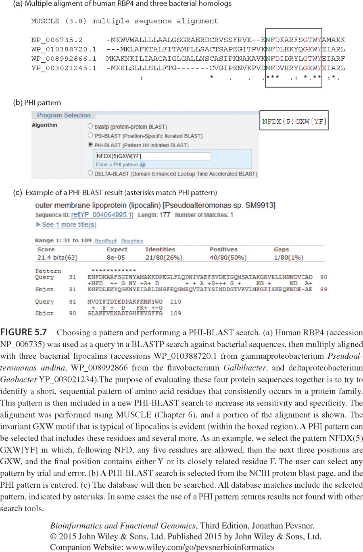
PHI-BLAST: Pattern hit initiated BLAST
Sometimes you have a protein query that has a known pattern. You can use PHI-BLAST to include that pattern, which can be user-selected or obtained from a database of such patterns such as PROSITE.
All resulting database matches must include that pattern (which is indicated with asterisks *** in the output).
PHI-BLAST is specialized, and is not commonly used but can be very useful.
B&FG 3e
Fig. 5.7
Page 180

Slide 40
Choosing a pattern and performing a PHI-BLAST search
Inspect an alignment, choose a pattern (manually).
Follow the rules for the syntax of your pattern.
The output includes asterisks indicating the position of your pattern.
B&FG 3e
Fig. 5.7
Page 180
Try it to boost sensitivity of your search.

Slide 41
Outline
Introduction
Specialized BLAST sites
Organism-specific BLAST sites; specialized algorithms Finding distantly related proteins: PSI-BLAST) and DELTA-BLAST Reverse Position-Specific BLAST Domain enhanced lookup time Accelerated BLAST (DELTA-BLAST) Assessing performance of PSI-BLAST and DELTA-BLAST Pattern-hit initiated BLAST (PHI-BLAST)
Profile searches: Hidden Markov Models and HMMER
BLAST-like alignment tools to search genomic DNA
Benchmarking to assess genomic alignment performance
PatternHunter, BLASTZ, Enredo/Pecan, MegaBLAST, BLAT, LAGAN, SSAHA2
Aligning NGS reads to a reference genome
Alignment based on hash tables; Burrows–Wheeler transform
Perspective

Slide 42
Multiple sequence alignment to profile HMMs
• In the 1990’s people began to see that aligning sequences to profiles gave much more information than pairwise alignment alone.
• Hidden Markov models (HMMs) are “states”
that describe the probability of having a
particular amino acid residue at arranged
in a column of a multiple sequence alignment
• HMMs are probabilistic models (unlike DELTA-BLAST and PSI-BLAST)

Slide 43
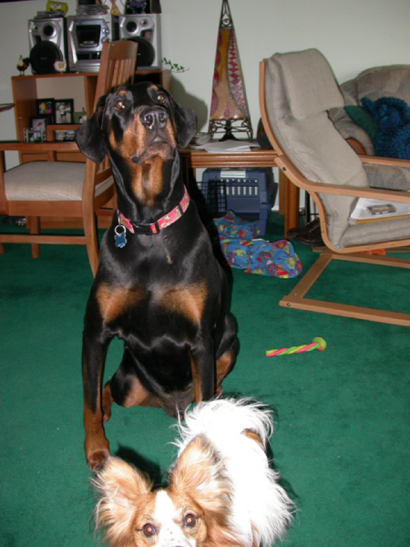
Simple Markov Model
Rain = dog may not want to go outside
Sun = dog will probably go outside
0.85
S
0.15
0.8
R
Markov condition = no dependency
on anything but nearest previous state
(“memoryless”)
0.2
courtesy of
Sarah Wheelan

Slide 44
Simple Hidden Markov Model
0.85
P(dog goes out in rain) = 0.1
P(dog goes out in sun) = 0.85
S
0.8
0.15
R
Observation: YNNNYYNNNYN
(Y=goes out, N=doesn’t go out)
What is underlying reality (the hidden state chain)?
0.2

Slide 45
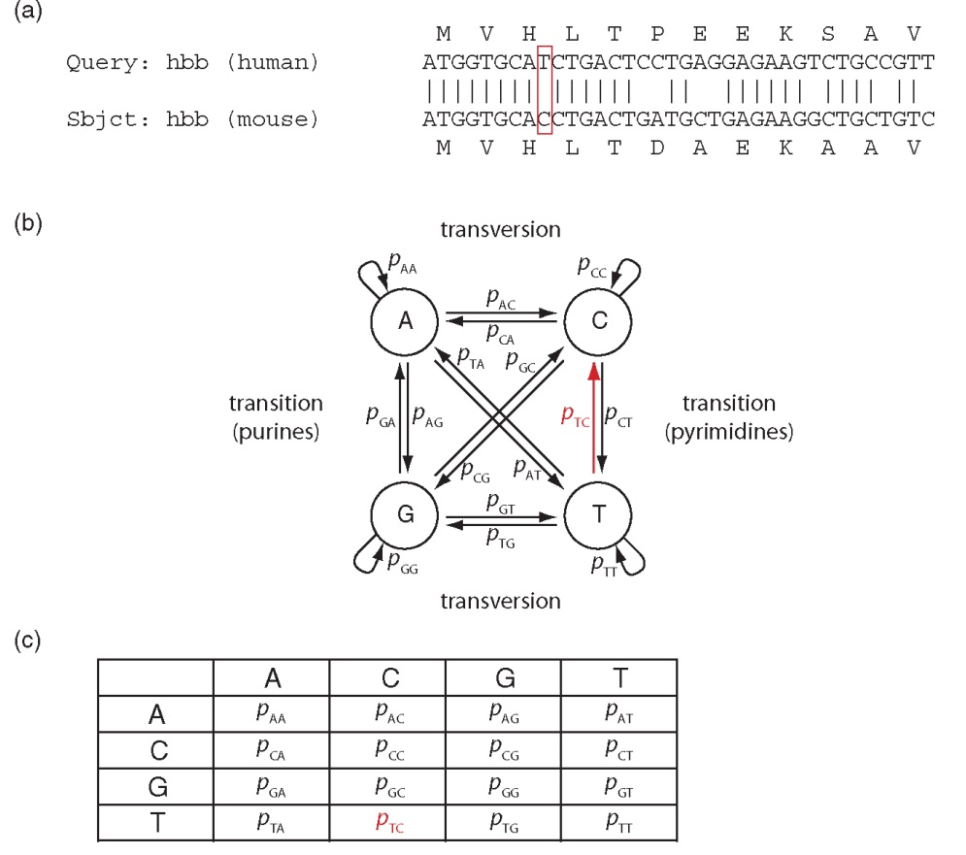
A hidden Markov model describes the transition probabilities for the alignment of nucleotides (shown here) or amino acids
B&FG 3e
Fig. 5.8
Page 182

Slide 46
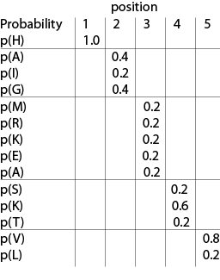
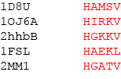
Consider five globin protein segments (each consisting of five amino acids)
We can describe the probability of occurrence of an amino acid at each position

Slide 47
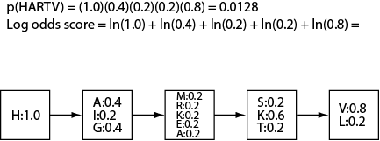
We can further describe the probability of occurrence of a protein sequence we have not encountered (e.g. HARTV)

Slide 48
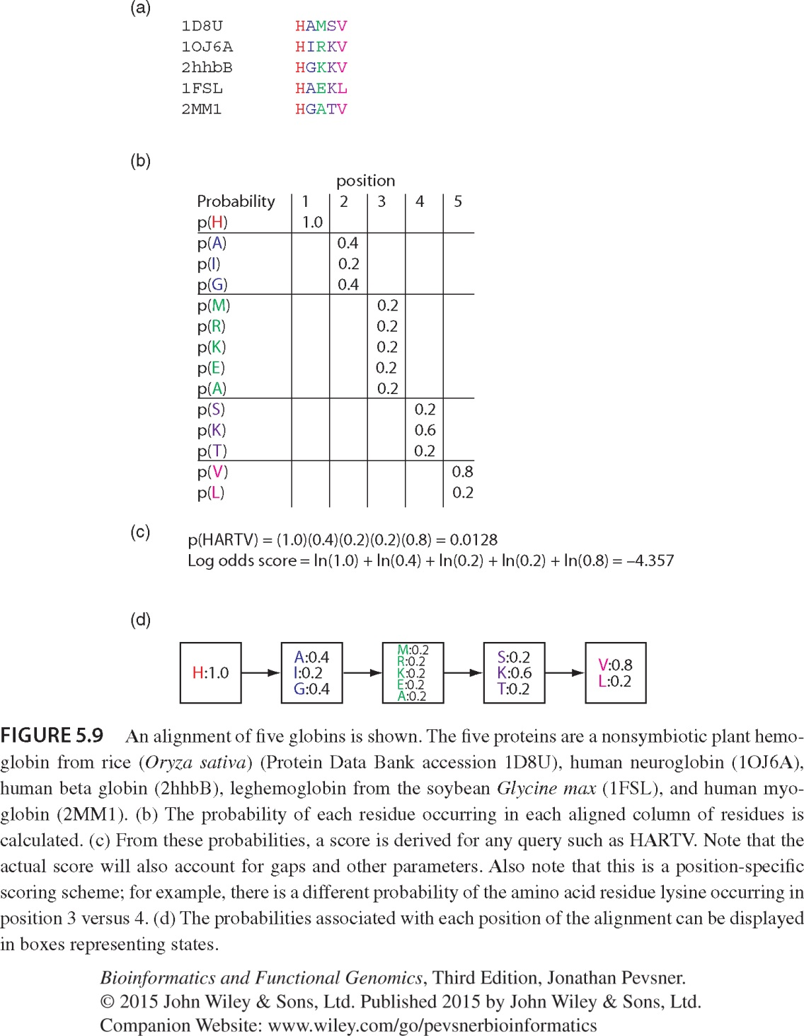
We can further describe the probability of occurrence of a protein sequence we have not encountered (e.g. HARTV)
B&FG 3e
Fig. 5.9
Page 183

Slide 49
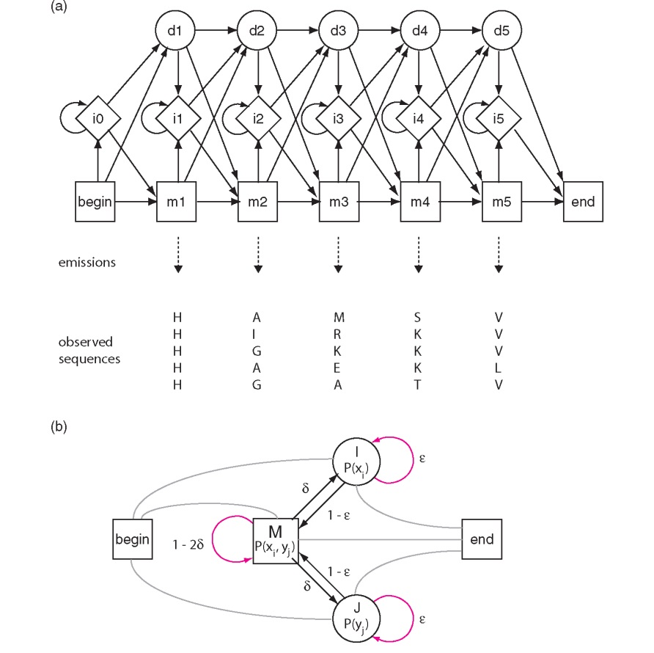
B&FG 3e
Fig. 5.10
Page 184

Slide 50
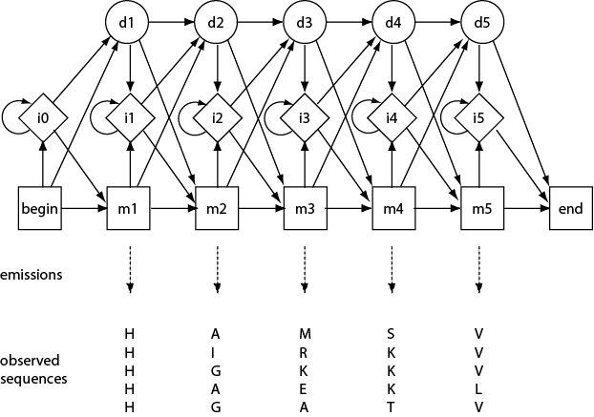
A hidden Markov model (HMM) includes beginning and end states, insertion and deletion states, and probabilities that explain the observed sequences

Slide 51
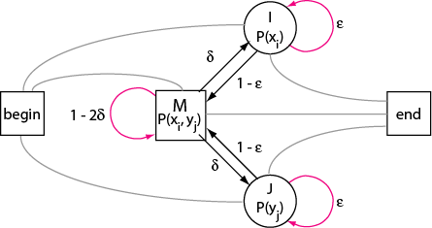
A pairwise HMM describes how two sequences are aligned

Slide 52
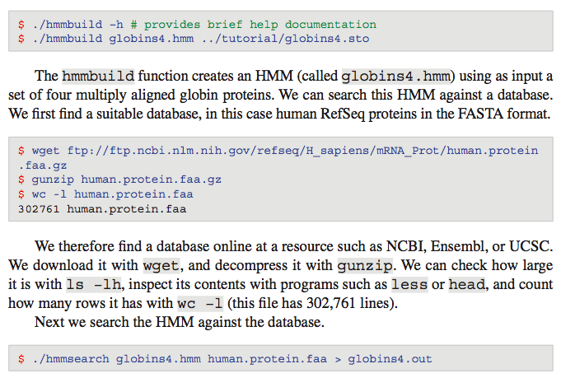
HMMER software: build profiles, complement BLAST
Build a profile HMM (input is a multiple sequence alignment)
Download a database to search (e.g. human RefSeq proteins)
Search an HMM against a database

Slide 53
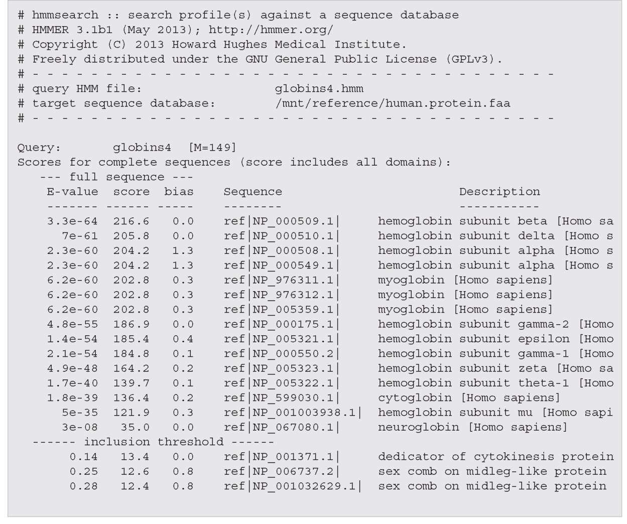
Use HMMER to build a profile HMM then search a database
B&FG 3e
Fig. 5.11
Page 186
HMMER output includes scores, E values

Slide 54
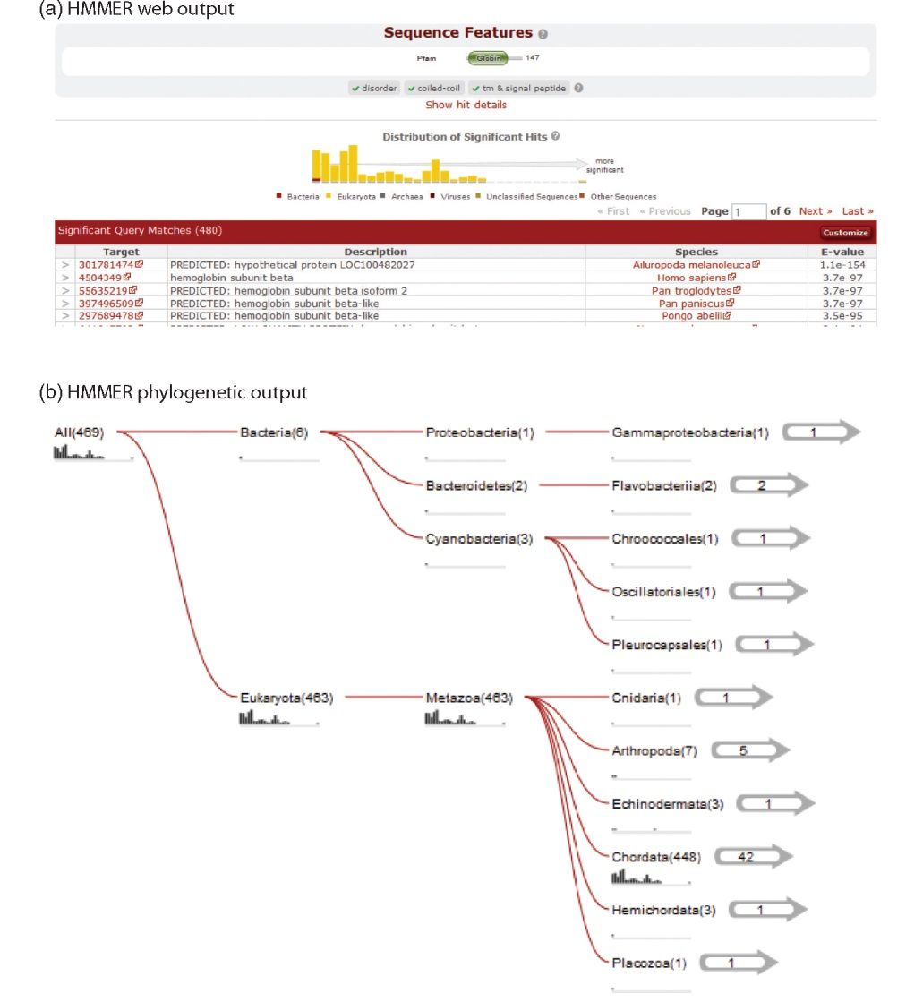
HMMER is available online
B&FG 3e
Fig. 5.12
Page 187

Slide 55
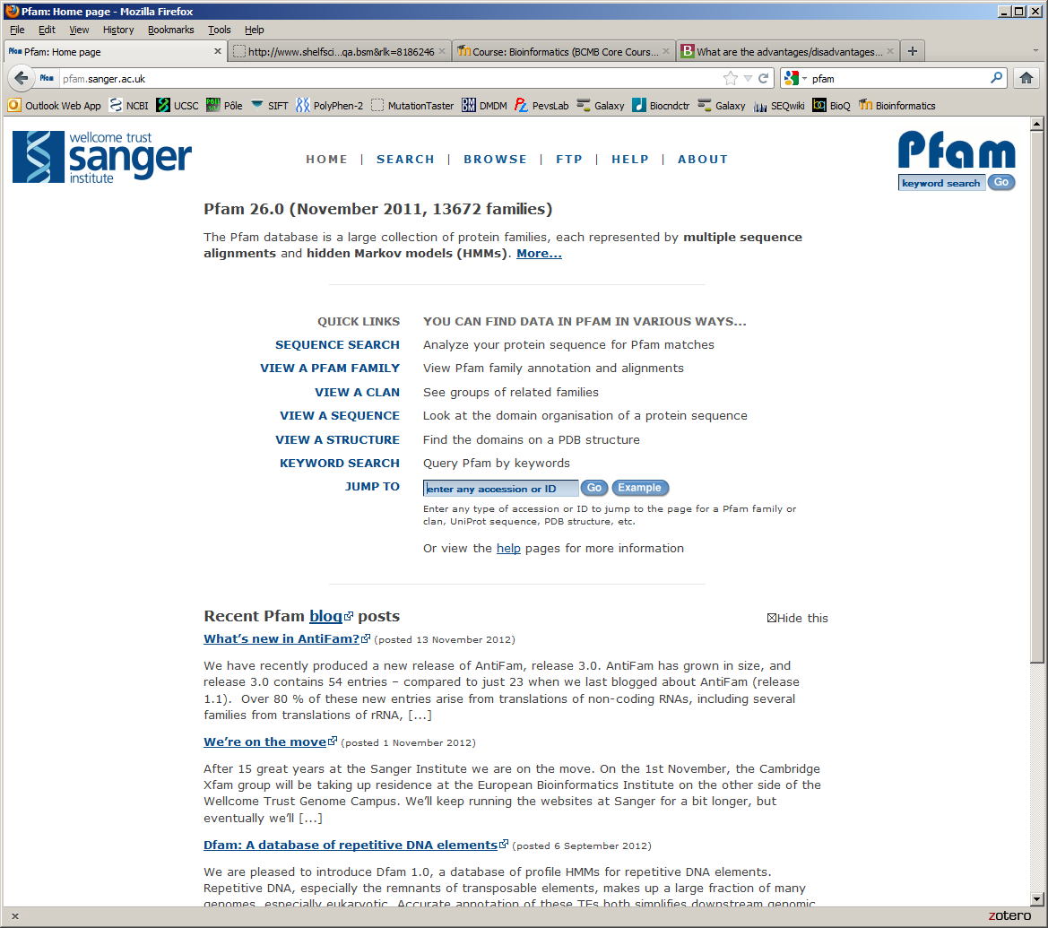
PFAM is a database of HMMs
and an essential resource for protein families
http://pfam.sanger.ac.uk/

Slide 56
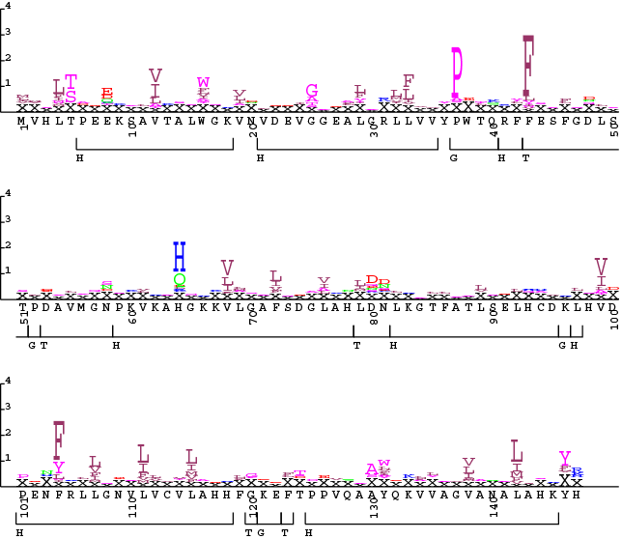
HMM logos graphically depict the likelihood of observed amino acids
Available at PFAM

Slide 57
Outline
Introduction
Specialized BLAST sites
Organism-specific BLAST sites; specialized algorithms Finding distantly related proteins: PSI-BLAST) and DELTA-BLAST Reverse Position-Specific BLAST Domain enhanced lookup time Accelerated BLAST (DELTA-BLAST) Assessing performance of PSI-BLAST and DELTA-BLAST Pattern-hit initiated BLAST (PHI-BLAST)
Profile searches: Hidden Markov Models and HMMER
BLAST-like alignment tools to search genomic DNA
Benchmarking to assess genomic alignment performance
PatternHunter, BLASTZ, Enredo/Pecan, MegaBLAST, BLAT, LAGAN, SSAHA2
Aligning NGS reads to a reference genome
Alignment based on hash tables; Burrows–Wheeler transform
Perspective

Slide 58
BLAST-related tools for genomic DNA
The analysis of genomic DNA presents special challenges:
There are exons (protein-coding sequence) and
introns (intervening sequences).
There may be sequencing errors or polymorphisms
The comparison may between be related species
(e.g. human and mouse)

Slide 59
BLAST-related tools for genomic DNA
Recently developed tools include:
MegaBLAST at NCBI.
BLAT (BLAST-like alignment tool). BLAT parses an entire
genomic DNA database into words (11mers), then
searches them against a query. Thus it is a mirror image
of the BLAST strategy. See http://genome.ucsc.edu
SSAHA at Ensembl uses a similar strategy as BLAT.
See http://www.ensembl.org
Page 162

Slide 60
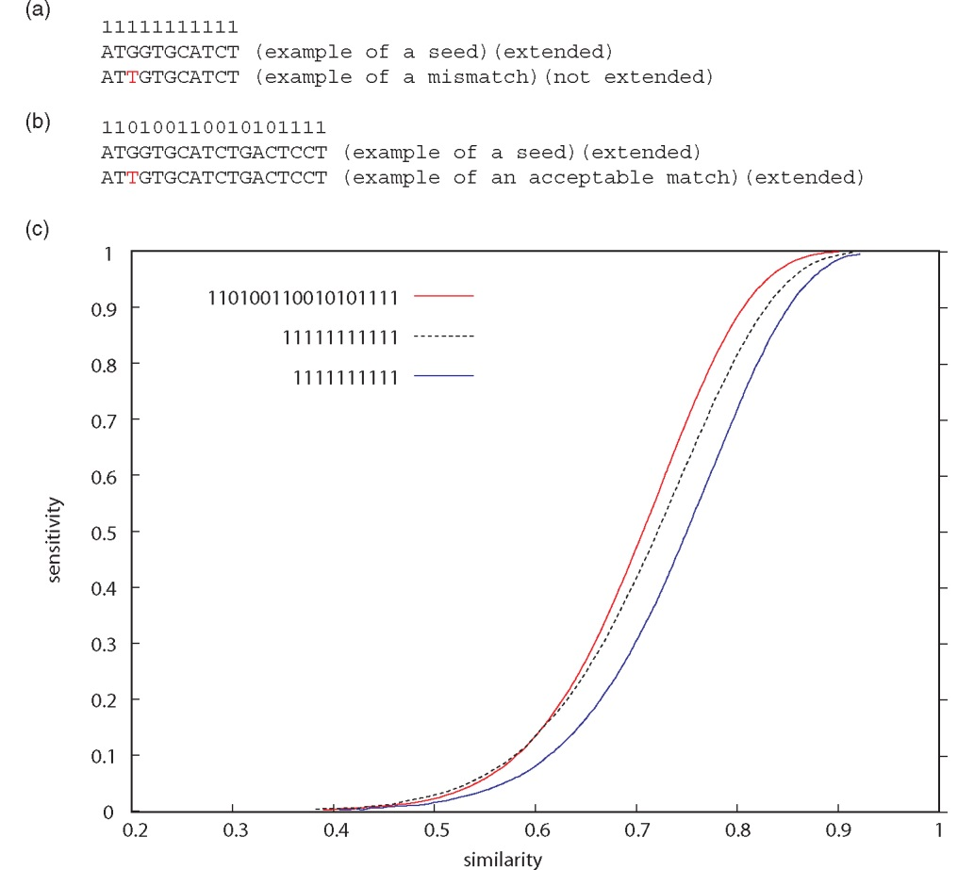
PatternHunter uses long seeds with mismatches to improve sensitivity
11111111111
110100110010101111
sensitivity
B&FG 3e
Fig. 5.13
Page 189
similarity

Slide 61
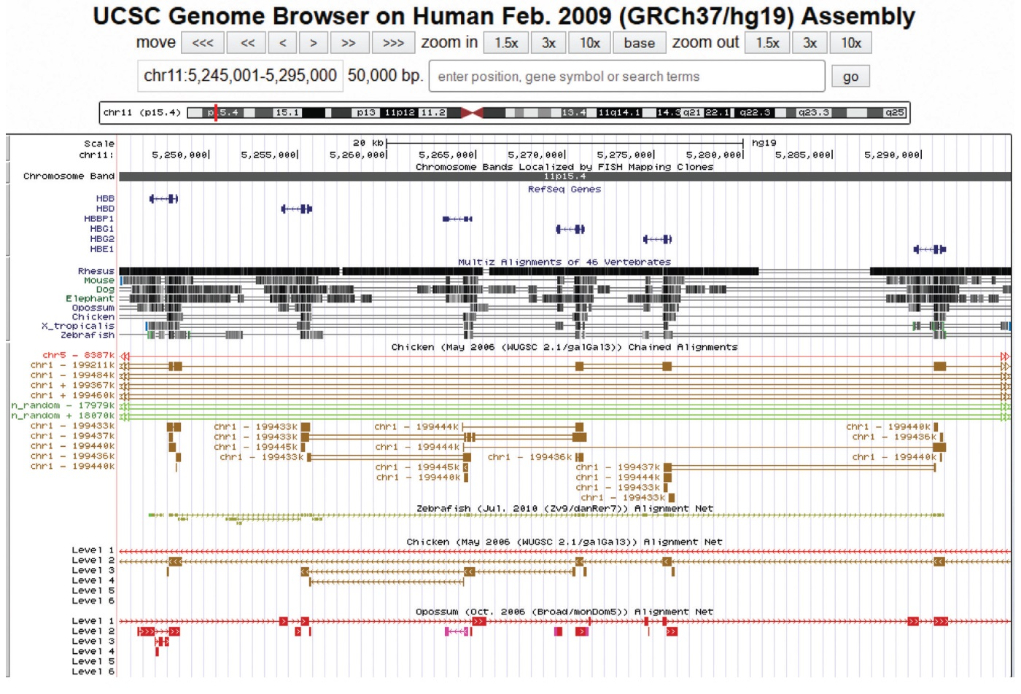
BLASTZ alignments at UCSC
B&FG 3e
Fig. 5.14
Page 190
50 kilobases at the beta globin locus are displayed, including BLASTZ alignments.

Slide 62
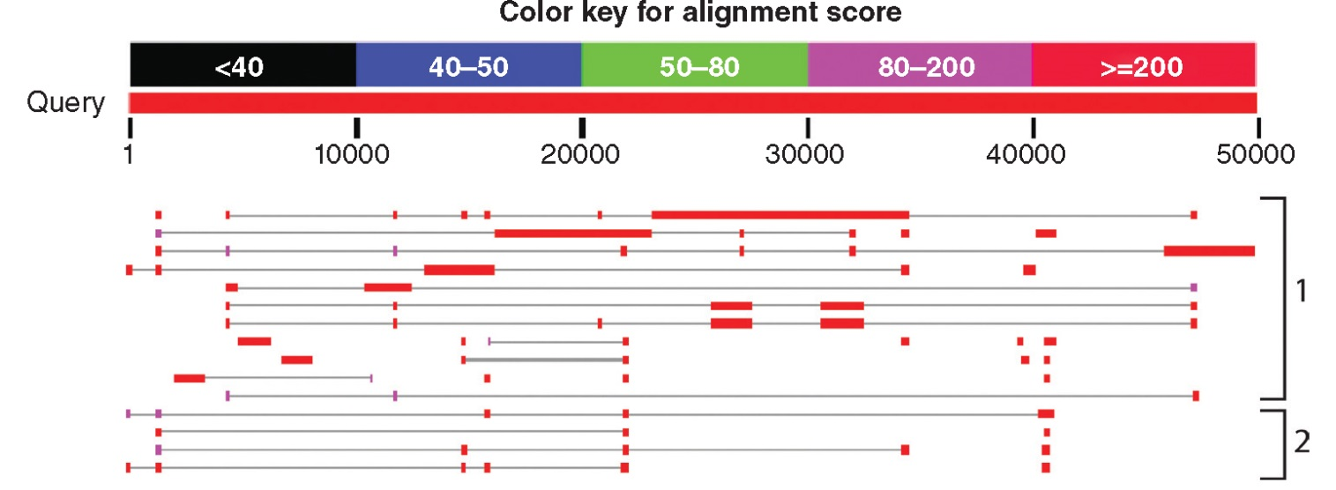
MegaBLAST: extremely fast searches with large seeds
--very fast
--uses very large word sizes (e.g. w=28, up to w=256)
--use it to align long, closely related sequences
--Choose discontiguous megablast for cross-species comparisons (tolerates mismatches)
B&FG 3e
Fig. 5.15
Page 192

Slide 63
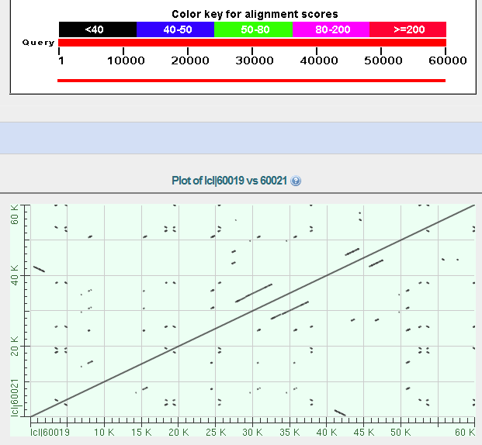
MegaBLAST output
60 kb of the human beta globin locus versus itself!
Dot matrix view

Slide 64
MegaBLAST output
60 kb of the human beta globin locus versus itself!
main diagonal reflects exact matches
off diagonal reflects duplications
Flipped, off diagonal reflects inversions

Slide 65
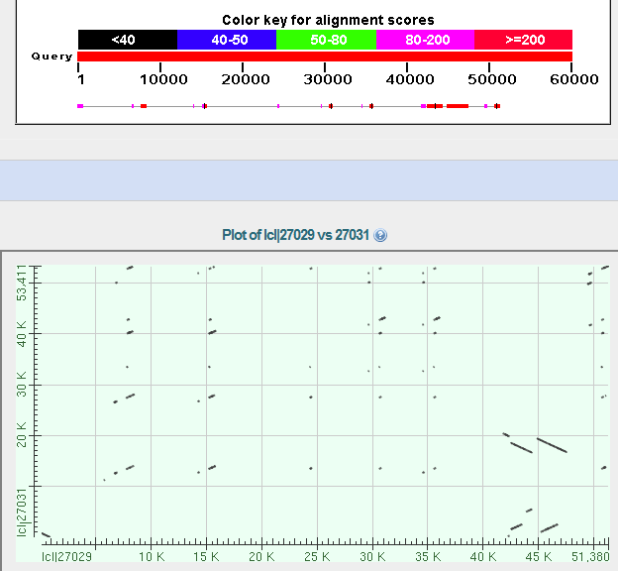
MegaBLAST output
60 kb of the human beta globin locus versus 60 kb of the mouse beta globin locus

Slide 66
BLAT indexes a whole genomic database rather than a query
“BLAT on DNA is designed to quickly find sequences of 95% and greater similarity of length 40 bases or more. It may miss more divergent or shorter sequence alignments. It will find perfect sequence matches of 33 bases, and sometimes find them down to 20 bases. BLAT on proteins finds sequences of 80% and greater similarity of length 20 amino acids or more. In practice DNA BLAT works well on primates, and protein blat on land vertebrates.” --BLAT website

Slide 67
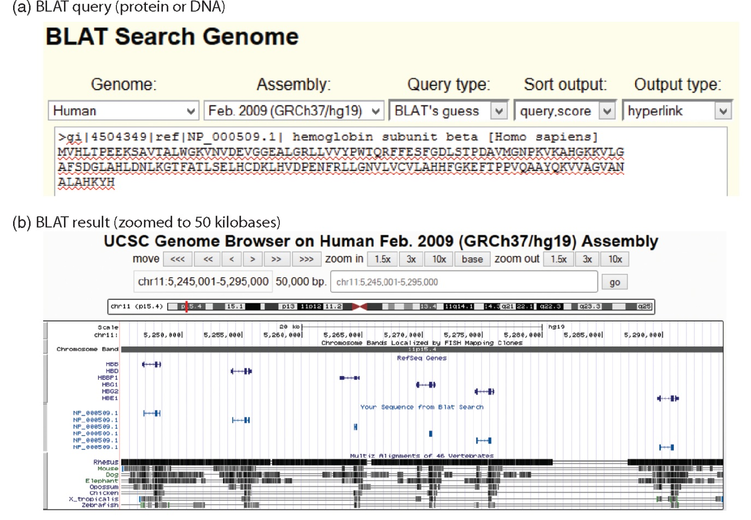
BLAT indexes a whole genomic database rather than a query
Paste DNA or protein sequence
here in the FASTA format
B&FG 3e
Fig. 5.16
Page 193

Slide 68
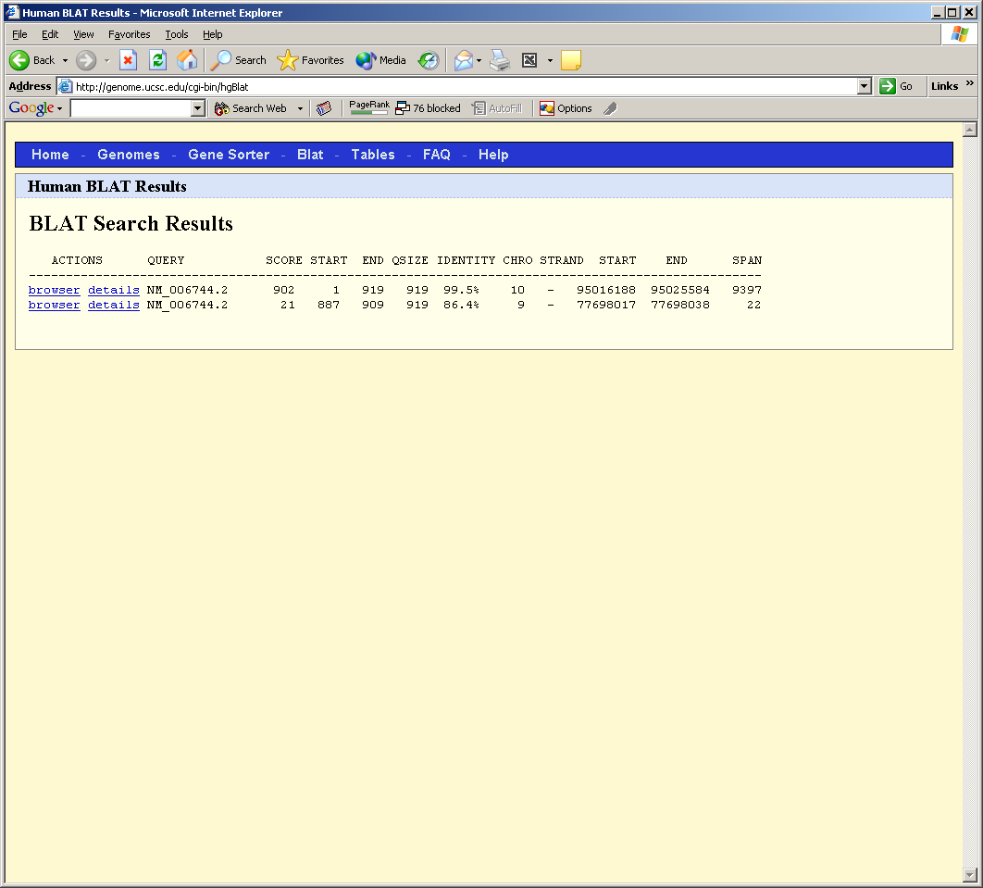
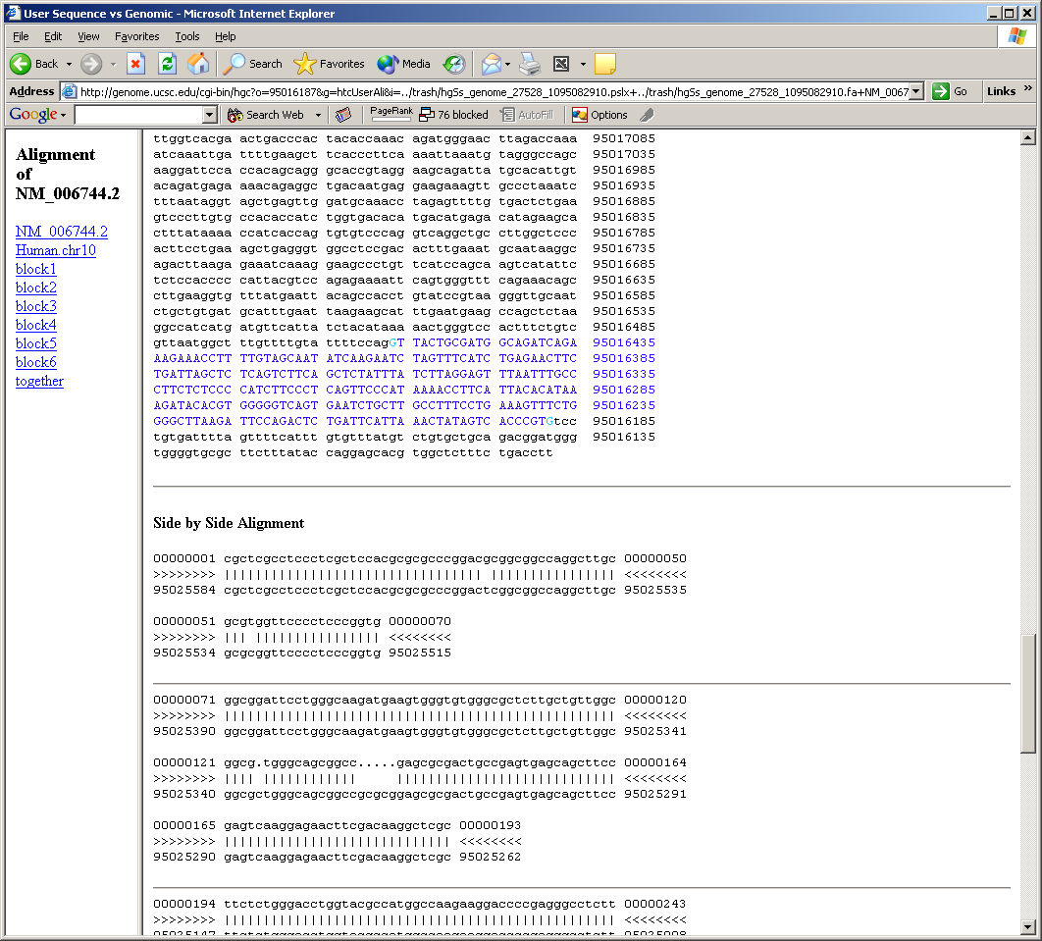
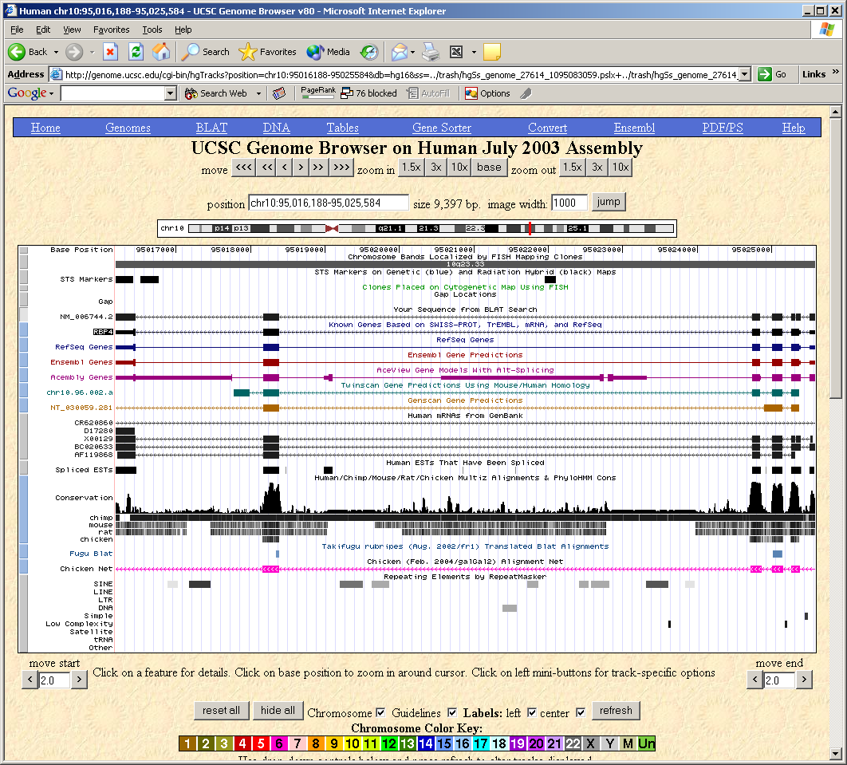
BLAT output includes browser and other formats

Slide 69
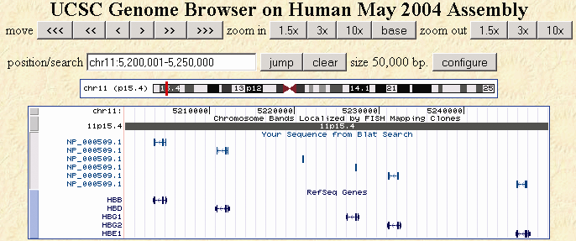
BLAT output includes browser and other formats
This example shows a BLAT query of beta globin resulting in a series of matches to homologous, neighboring globins.

Slide 70
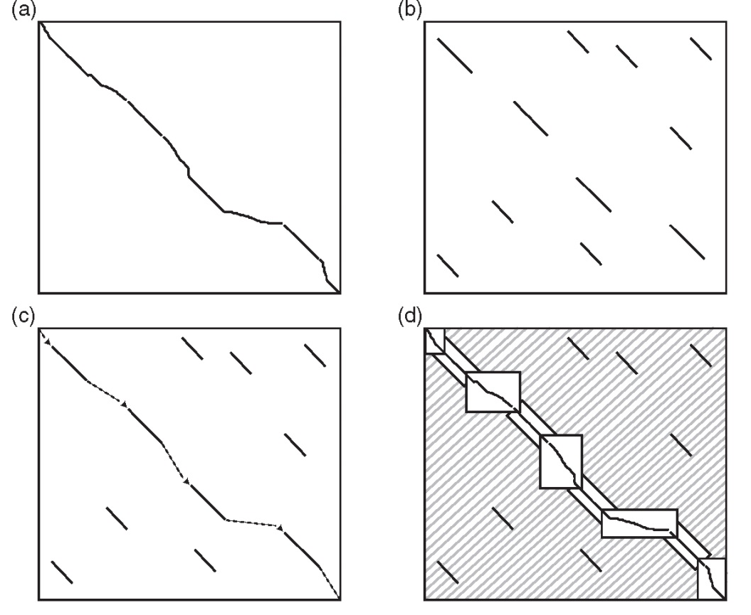
LAGAN (Limited Area Global Alignment of Nucleotides)
local alignment
identify anchors
join locally aligned segments in chains
compute optimal alignment in boxed areas
B&FG 3e
Fig. 5.17
Page 193

Slide 71
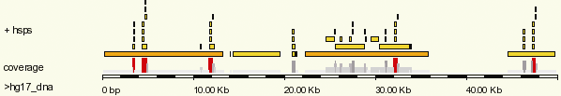
SSAHA
SSAHA converts a DNA database (with a reference sequence such as the human genome) into a hash table with user-selected fixed word lengths (k-mers). Reads are searched against this hash table for matches by pairwise alignment.

Slide 72
Outline
Introduction
Specialized BLAST sites
Organism-specific BLAST sites; specialized algorithms Finding distantly related proteins: PSI-BLAST) and DELTA-BLAST Reverse Position-Specific BLAST Domain enhanced lookup time Accelerated BLAST (DELTA-BLAST) Assessing performance of PSI-BLAST and DELTA-BLAST Pattern-hit initiated BLAST (PHI-BLAST)
Profile searches: Hidden Markov Models and HMMER
BLAST-like alignment tools to search genomic DNA
Benchmarking to assess genomic alignment performance
PatternHunter, BLASTZ, Enredo/Pecan, MegaBLAST, BLAT, LAGAN, SSAHA2
Aligning NGS reads to a reference genome
Alignment based on hash tables; Burrows–Wheeler transform
Perspective

Slide 73
Next-generation sequencing (NGS)
In NGS, many millions of short reads (~150 base pairs) must be aligned to a long reference (~3 billion base pairs).
BLAST would be unacceptably slow.
Current aligners use BLAST-related strategies such as hash tables, gapped and ungapped alignment, and long seeds.

Slide 74
Sequence alignment for next-generation sequencing
Applications include:
DNA sequencing (e.g. re-sequencing a human genome)
RNAseq (measuring RNA transcript levels)
ChIP-seq (finding protein binding sites)
Methylation studies (genome-wide)

Slide 75
Two approaches to sequence alignment for NGS
[1] Hash Tables
--BLAST seed and extension approach uses
hash table indexing
--spaced seed aligners index the reads or the genome
--programs vary the number of spaced seeds, the read length, memory usage, and sensitivity requirements
--some require multiple seed matches
--some allow gaps
[2] Suffix trees
--Step 1: identify exact matches
--Step 2: build alignments supported by exact matches
--Example: MUMmer (maximal unique matches)
--Example: Bowtie and BWA

Slide 76
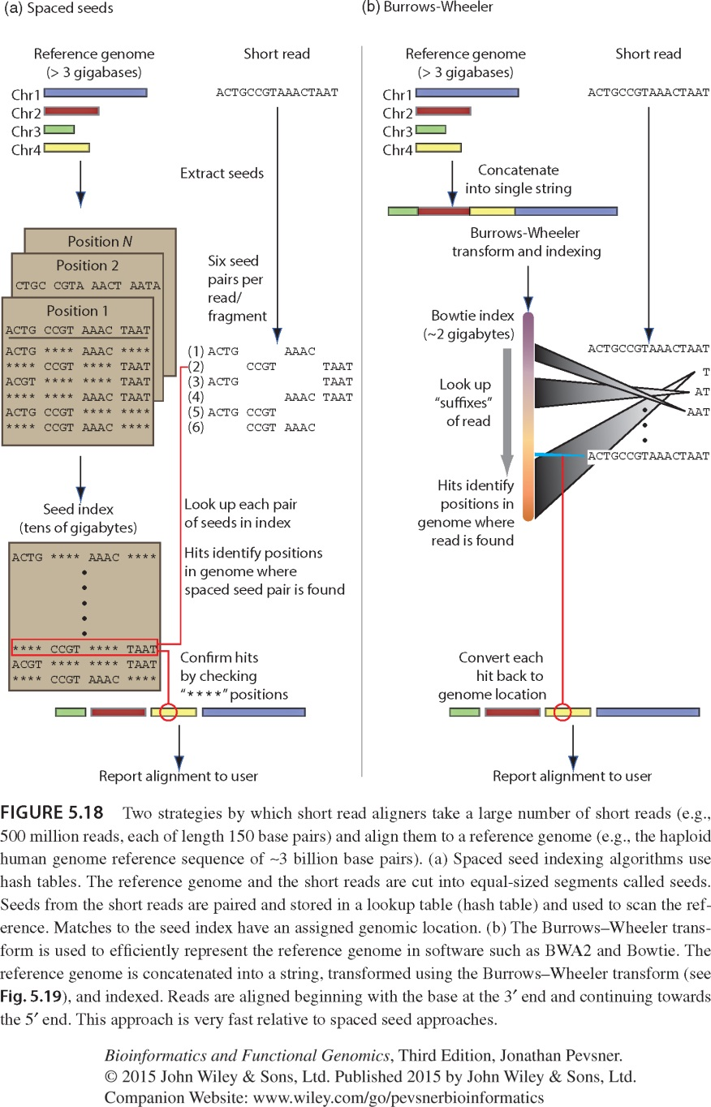
Spaced seed strategy for alignment of many short reads to a large reference genome
Maq uses spaced seed indexing
Cut the reference genome into “seeds”
Store seeds in look-up table
Cut each read into seeds
Allow up to 2 mismatches in seed pairing reads to the reference
B&FG 3e
Fig. 5.18
Page 195
PMID: 19430453

Slide 77
Burrows-Wheeler strategy for alignment of many short reads to a large reference genome
Bowtie uses the Burrows-Wheeler transform (BWT)
Create a memory-efficient representation of the reference genome (need <2 GB memory; Maq may require >50 GB)
Align a read one base at a time to a BWT transformed genome
Progressively solve the alignment of 1 character, then 2, then 3, etc.
30-fold faster than Maq
B&FG 3e
Fig. 5.18
Page 195

Slide 78
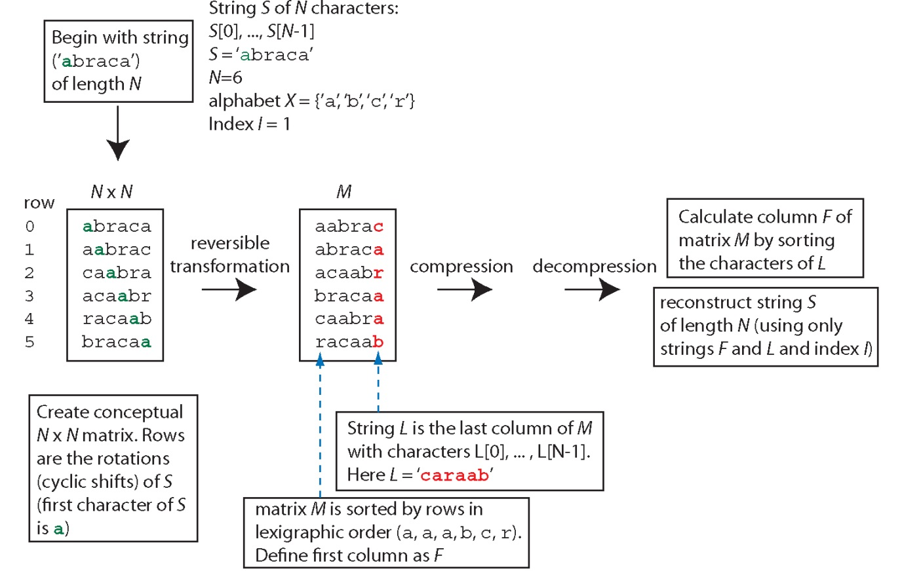
Burrows-Wheeler Transform (BWT): a string (e.g. a reference genome) is compressed then decompressed to facilitate alignment
B&FG 3e
Fig. 5.19
Page 196

Slide 79
Outline
Introduction
Specialized BLAST sites
Organism-specific BLAST sites; specialized algorithms Finding distantly related proteins: PSI-BLAST) and DELTA-BLAST Reverse Position-Specific BLAST Domain enhanced lookup time Accelerated BLAST (DELTA-BLAST) Assessing performance of PSI-BLAST and DELTA-BLAST Pattern-hit initiated BLAST (PHI-BLAST)
Profile searches: Hidden Markov Models and HMMER
BLAST-like alignment tools to search genomic DNA
Benchmarking to assess genomic alignment performance
PatternHunter, BLASTZ, Enredo/Pecan, MegaBLAST, BLAT, LAGAN, SSAHA2
Aligning NGS reads to a reference genome
Alignment based on hash tables; Burrows–Wheeler transform
Perspective

Slide 80
Perspective
For database searching there continue to be many innovative approaches to improve sensitivity and specificity.
We discussed DELTA-BLAST which is usually the best algorithm for any protein search.
For DNA searches innovative spaced seed approaches have greatly increased search speed.
For next-generation sequence data (Chapter 9) many algorithms have been introduced to align a vast number of reads (e.g. 1 billion short reads) to a large reference genome (e.g. the ~3 billion base pair human reference genome).
B&FG 3e
Page 197

